Slide 1
Welcome
Fish 558; Day1: 13h30-15h30
Notes:
a

Slide 2
Aims of this Workshop
Introduce students to:
  Decision Analysis
  Bayesian Analysis
    Principles
    The Sample-Important-Resample Algorithm
    The Markov chain Monte Carlo Algorithm
Conduct several in-class examples.

Slide 3
Statistical
Background
Fish 558; Day1: 09h30-10h30
Notes:
a

Slide 4
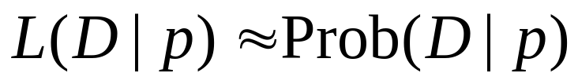
Maximum Likelihood
Given a set of data, and a probability model, maximum
likelihood chooses the values for the parameters that make
the data “most likely”.
The likelihood of the data D given the parameter(s) p is the
probability of the data given the parameter(s).
Note:
Probability: knowing parameters -> predicting data.
Likelihood: knowing data -> parameter estimation.

Slide 5
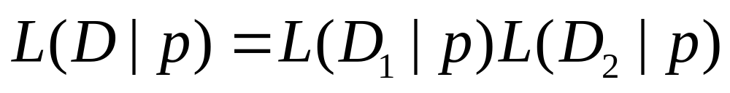
Basics of Likelihood
If the data consists of two parts D₁ and D₂, the likelihood
of the data D=D₁+D₂ is the product of the likelihoods
of each of D₁ and D₂:
Data point 1
Data point 2

Slide 6
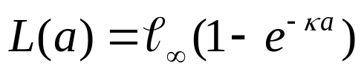
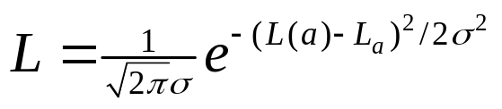
Further Likelihood Considerations
To compute the likelihood for a given set of
parameters we need:
The deterministic (model) relationship between the input
variables (covariates) and the (expected) data:
How the data pertain to the model prediction – the
“sampling” distribution (in this case normal), i.e.:
Model prediction
Data

Slide 7
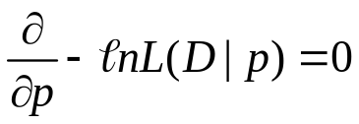
Maximum Likelihood
Given a likelihood function, we find the maximum likelihood
values for the parameters of the model, by maximizing the
log-likelihood, or minimizing the negative log-likelihood, i.e.:
Naturally, it is seldom the case that one can solve this
equation but it is possible (such as a linear regression).

Slide 8
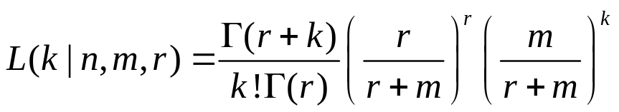
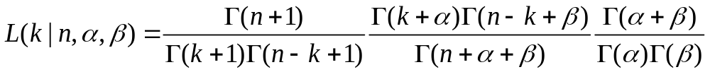
Thoughts on likelihoods
It is traditional to assume that count data are Poisson
distributed and yes-no data are binomial, but actual data are usually overdispersed. If these cases one should assume:
Negative binomial likelihood:
Beta-binomial likelihood:

Slide 9
Minimizing functions
mle - minimize a real-valued function f subject to constraints (in library stats4).
optim – minimize a real-valued function f subject to constraints.
nlminb – minimizes an constrained (or unconstrained) function.

Slide 10
Non-linear Minimization in R
Although optim/mle is fairly powerful, it is also generally fairly slow. Therefore, except for some very simple problems, I strongly advocate the use of AD Model Builder to minimize functions.
Optim/mle applies one of several methods (quasi-Newton [BFGS], simplex [Nelder-Mead], and conjugate-gradient[CG])and can make use of derivatives and the Hessian matrix (if they are available). It also includes options to use Simulated Annealing.

Slide 11
Calling optim-I
optim(pars, fn, gr, method, control, lower, upper, hessian)
Required parameters:
  pars – a vector of parameters (the initial guesses).
  fn – the objective function – that which is to be minimized.
Optional parameters:
  gr – R function that computes the gradient.
  hessian – should the Hessian matrix be computed?

Slide 12
Calling optim-II
Optional parameters:
  method – which of the various types of minimization algorithm to use.
  control – parameters used to control the minimization (maximum iterations, function calls, etc.).
  lower / upper – vector of lower and upper bounds for the parameters (including –Inf / Inf).

Slide 13
Calling optim-III
(Key) outputs:
  par – the estimates of the parameters.
  value – the lowest value of the objective function.
  counts – number of function and gradient calls.
  convergence – code indicating whether convergence occurred.
  message – additional information
  hessian – estimate of the Hessian matrix at the solution.

Slide 14
Calling mle - I
mle(minuslogl, start, method, fixed,lower,upper)
minuslogl – the negative log-likelihood function – that which is to be minimized.
start – a named list of estimated parameters (the initial guesses).
fixed – a named list of parameters which are passed to the objective function.
method – which of the various types of minimization algorithm to use.

Slide 15
Calling mle - II
The methods associated with mle can be used to:
  Extract the log-likelihood (logLik)
  Extract the estimated parameters (coef)
  Extract the variance-covariance matrix (vcov)
mle provides estimates of the standard errors of the estimates (unlike optim).
Hint: mle makes computing profile likelihood very easy (compared to optim)

Slide 16




Likelihood Profile-I
Likelihood profile is a way to estimate a confidence interval for
the estimate of a model parameter when the model is fitted
using maximum likelihood.
The problem. We have a model based on a vector of
parameters . One of these parameters is “p” and we want
a x% confidence interval for it. The negative log-likelihood
function for this problem is or (separating out p),
. Note: .

Slide 17





Likelihood Profile-II
The steps in computing a likelihood profile:
  Fit the model to find the maximum likelihood
  estimates for the parameters and also the lowest
  negative log-likelihood .
  Select a wide range of values for p.
  For each value of p=A, find the values for the
  parameters such that is
  minimized. Record the negative log-likelihood for
  each value of p,
  Plot against p.

Slide 18
Likelihood Profile-I
Negative log-likelihood, fixing the
parameter to each value in turn
(minimize on the rest of the parameters)
-log
likelihood
MLE
•
•
•
•
•
•
•
Parameter of Interest
Alternative
values for the
parameter

Slide 19


Model Selection-I
Given N models which are all fitted to the same data set
(denoted D), we can identify the best approximating model
by calculating the AIC, BIC, etc.
where p_{i} is the number of parameters in model i and n is
the number of data points

Slide 20
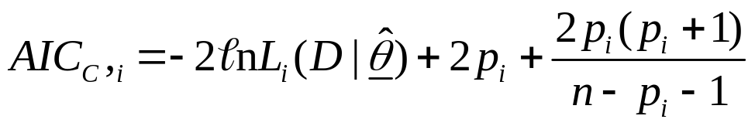
Model Selection-II
All things equal, BIC will select less complex models
than AIC. AIC_{c} takes small sample size effects into account:
I always use AIC_{c} but its effect is small for n >> p_{i}

Slide 21
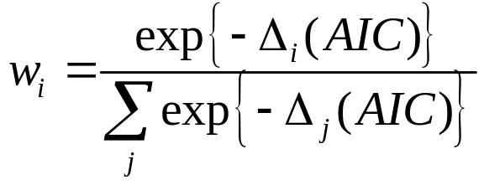

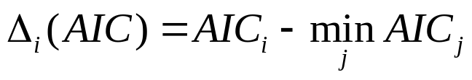
Model Selection-III
Models can be weighted with AIC and BIC, e.g.:
where is:

Slide 22
References
Wagenmakers, E-J and S. Farrell. 2004. AIC model selection using Akaike weights. Psyschonomic Bulletin & Review 11: 192-196.

